Slide 1
TENSORORBIT · EDA BOOTCAMP
Day 2: NumPy + Matplotlib
From numbers to insight — the engine under Pandas, and the pictures that make it land.
22 August 2026 · 5:30 PM · SCI Lab · Facilitator: Fathima Wazna

Slide 2
THE CONNECTED JOURNEY
Where today fits in the bigger picture
Day 1
Day 2 (today)
Day 3
Day 4
Pandas — load, clean,
explore the data
→
NumPy — the engine
underneath. Matplotlib —
turn it into pictures
→
Combine everything on
a business dataset
→
Present findings +
recommendations
Say this out loud: Pandas columns are actually NumPy arrays underneath — that's why yesterday's tools were fast.
TensorOrbit EDA Bootcamp · Day 2
2

Slide 3
THE CORE IDEA
Why NumPy? Vectorisation, not loops
Plain Python
NumPy
doubled = [] for x in values: doubled.append(x * 2) One value at a time.
Slow at scale.
doubled = values * 2 The whole array at once.
No explicit loop — this is
"vectorisation."
Ask the class first: "How would YOU double a million numbers in plain Python?" — then reveal the NumPy version.
TensorOrbit EDA Bootcamp · Day 2
3

Slide 4
TODAY'S NUMPY TOOLKIT
Five things NumPy will do for us
1
2
3
4
5
Arrays & indexing
Vectorised math
Stats
Outlier concept
Correlation
Create, slice, filter (1D)
+ − × ÷ across whole columns
mean, median, std, percentiles
Z-score & IQR formulas — seen via boxplot, not hand-coded
np.corrcoef() — reading the matrix
Each of these feeds straight into a chart in the Matplotlib half of today's session.
TensorOrbit EDA Bootcamp · Day 2
4

Slide 5
CONCEPT ONLY — NO MANUAL CODING TODAY
Catching outliers before they distort your averages
One extreme value can badly skew a mean or a trendline. Two common ways to define one mathematically:
Z-SCORE METHOD
IQR METHOD
How many standard deviations a point sits from the mean.
Based on the middle 50% of the data (Q1 to Q3), not the mean — less thrown off by extreme values itself.
z = (x − mean) / std
Rule of thumb: |z| > 3 → outlier
IQR = Q3 − Q1
Outlier if < Q1−1.5·IQR
or > Q3+1.5·IQR
We won't hand-code these formulas today — in a few minutes, a boxplot will show these same outliers visually, which is clearer for everyone in the room.
TensorOrbit EDA Bootcamp · Day 2
5

Slide 6
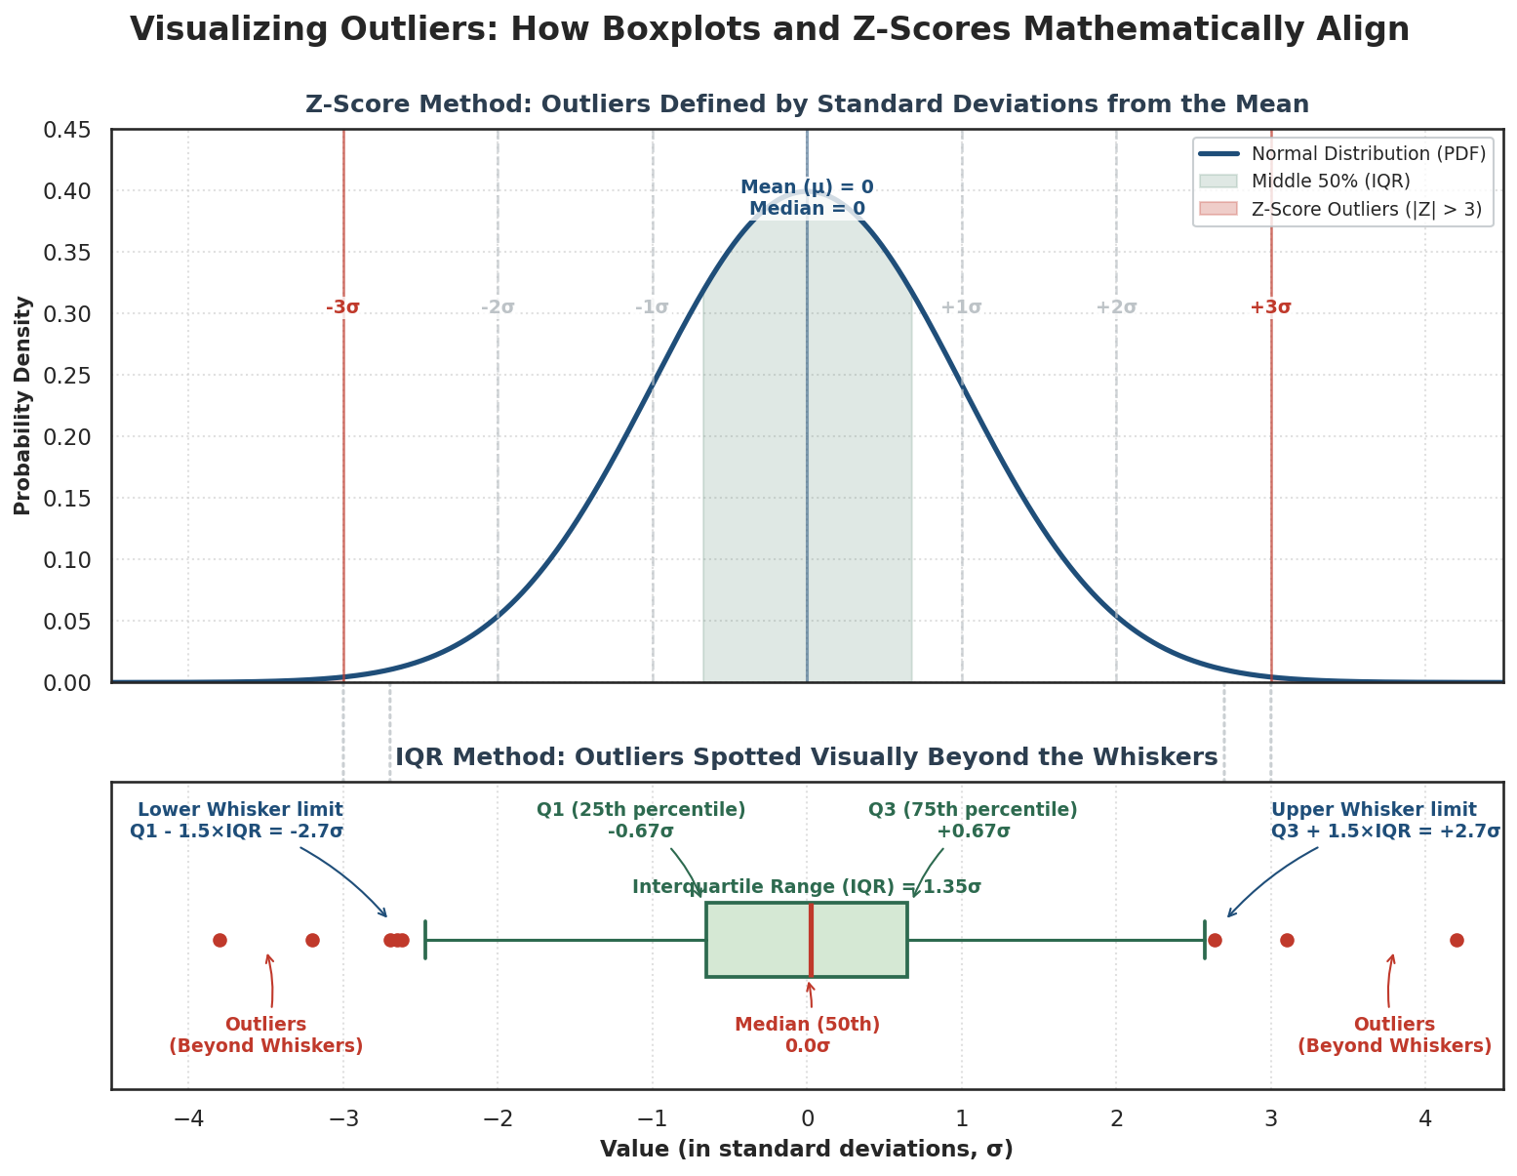

Slide 7
CONCEPT ONLY — NO CODE
Correlation vs. causation
"Cities with more renewable energy also have less CO2 — does renewable energy CAUSE that, or could both be driven by something else, like wealth or policy?"
Correlation:
two variables move together
Causation:
one variable directly produces the change in another
np.corrcoef() only ever tells you the first one.
TensorOrbit EDA Bootcamp · Day 2
6

Slide 8
TRANSITION TO MATPLOTLIB
Why visualise what we just calculated?
A mean.
An outlier list.
A correlation number.
A chart
Tells the story in 5 seconds. This is exactly the skill Day 4's presentations will demand.
→
None of it lands with
an audience the way
a picture does.
TensorOrbit EDA Bootcamp · Day 2
7

Slide 9
REFERENCE
Which chart for which question?
CHART
USE WHEN...
TODAY'S EXAMPLE
Line
How does X change over time?
Yearly avg. CO2 over 2019–2023
Bar
How do categories compare?
Top 10 cities by renewable %
Histogram
What's the shape of one variable's distribution?
Spread of CO2 values
Scatter
Is there a relationship between two variables?
Renewable % vs CO2
Boxplot
Where's the spread, and are there outliers?
CO2 outliers, visually
Pie
What's each part's share of a whole? (3–6 categories max)
Record share by top 5 countries
TensorOrbit EDA Bootcamp · Day 2
8

Slide 10
A LITTLE EXTRA POLISH GOES A LONG WAY
Making charts clearer: color and annotation
COLOR CAN CARRY MEANING
LABEL THE DATA DIRECTLY
Instead of one flat color for every bar, color bars differently based on a condition — e.g. green for cities above 50% renewable energy, light green for the rest. The color itself now tells part of the story.
Adding the exact value above each bar (an annotation) means the audience doesn't have to squint at the axis to read the numbers. Small addition, big clarity gain — especially useful for Day 4 presentations.
Also worth mentioning: putting two lines on one chart with a legend (renewable % vs recycling % over time) lets the audience compare two stories at once, instead of flipping between two separate charts.
TensorOrbit EDA Bootcamp · Day 2
9

Slide 11
GUIDED PRACTICE · ~25-30 MIN
Turn your own findings into charts
1
Which city had the highest average water usage per capita across all years? Show it.
2
Is there a relationship between green space % and recycling rate %? Show it.
3
How has the average recycling rate changed year over year? Show it.
Every chart needs: a title, axis labels, and a legend if it shows more than one series.
TensorOrbit EDA Bootcamp · Day 2
10

Slide 12
WRAP-UP
What you can do now — and what's next
TODAY YOU CAN...
DAY 3 PREVIEW
• Work with arrays instead of loops
• Calculate stats and percentiles
• Read a correlation matrix
• Build 6 chart types, with color and labels
• Combine charts with subplots
Combine Pandas + NumPy + Matplotlib into one full workflow, on a new business dataset — then your capstone brief.
TensorOrbit EDA Bootcamp · Day 2
11

